Slide 1
Telecommunication & Observation SYSTEM
Case Study: part 3

Slide 2
Organisation of the exercises
Black box modeling
Exercise 1: TOS and the CSCC
Exercise 2: TOS with all the external actors
Exercise 3: Health and position monitoring
White Box modeling:
Exercise 4: model the internal architecture of the TOS
For each exercise:
➔The simulation shall work,
The behaviour of the TOS shall be verified through the production of a sequence diagram
The sequence diagram shall be compared to the Reference Scenario

Slide 3
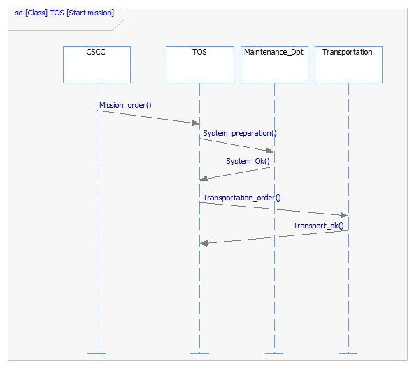
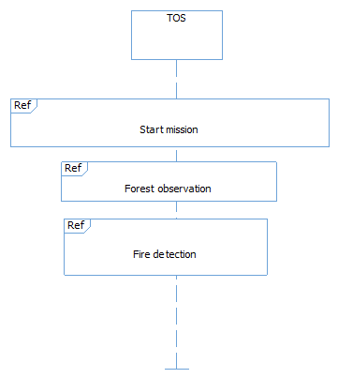
Reference scenario: Start mission part

Slide 4
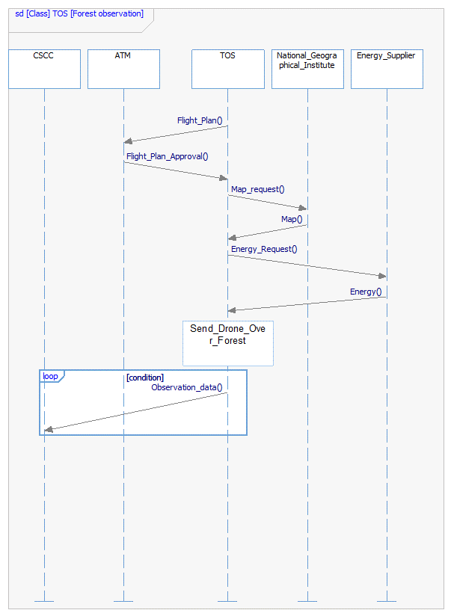
Reference scenario: Forest observation part

Slide 5
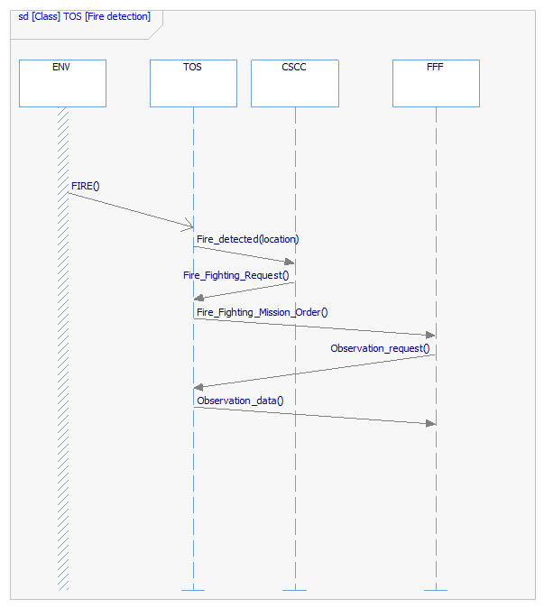
Reference scenario: Fire detection part

Slide 6
Exercise 1: Model and simulate the TOS as a black box
Analysis
Identify the messages exchanged with one external system (CSCC)
Modeling
Create a new project, in SysML mode
Create an Internal Block Diagram with the TOS and the CSCC modelled as parts
Connect the parts using standardport and connector
Insert in each part a StateChart, modelling the behaviour of the corresponding part

Slide 7
Exercise 2: All the external actors
Input: model TOS-All-Actors
Analysis
Complete the TOS behaviour in order to simulate completely the reference scenario
Modeling
Extend the TOS state machine with all the messages and states needed

Slide 8
Exercise 3: Health and position monitoring
Analysis
Introduction of parallel behaviours
Modeling
Extend the state machines of TOS and Maintenance Dpt in order to model the periodic emission fo Health_Status from the TOS
Extend the state machines of TOS and Online Positioning System in order to model the periodic reception of positioning information from the Online Positioning System

Slide 9
Exercise 4: White box Analysis
Analysis:
Define the internal architecture of the TOS (first level): one ground station, one Drone
Allocate the TOS functions to each component
Model the corresponding behviour
Modelling
Create an Internal Block Diagram in the TOS. Add parts for Ground Station and Drone. Establish the connections between the two
Create for Ground Station and Ddrone an internal statechart, modelling the functions and exchanges it is responsible for

